Slide 1
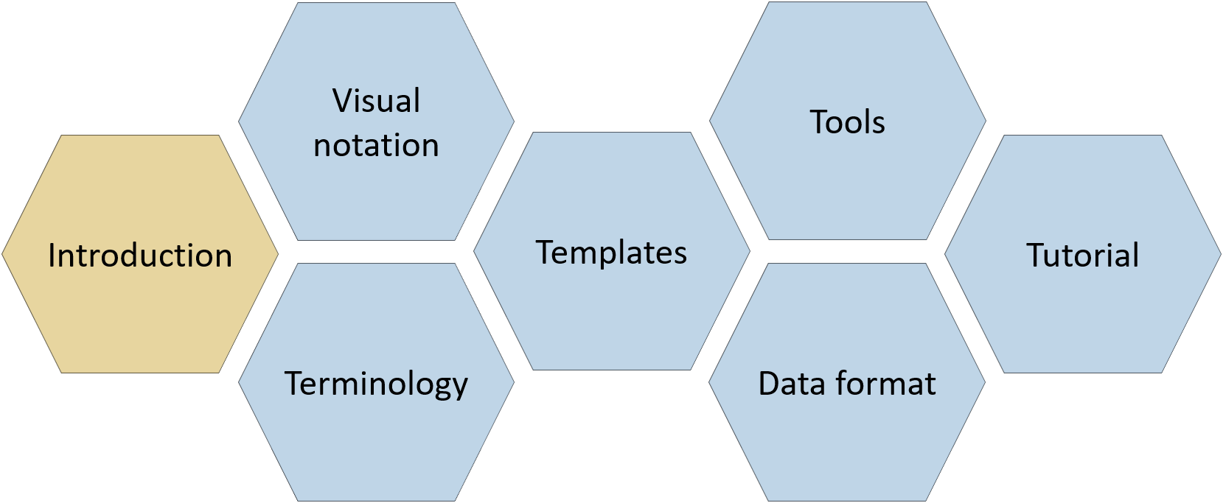
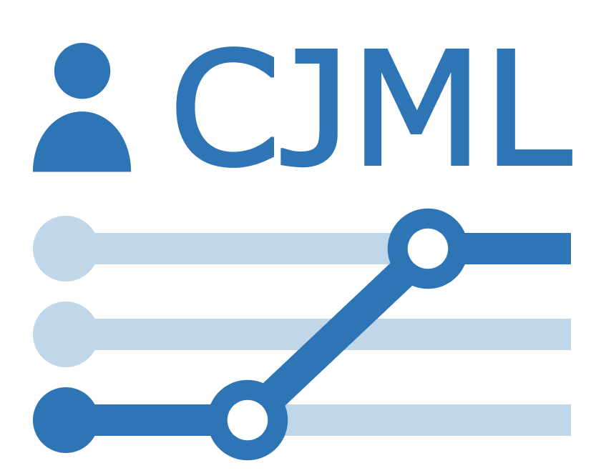
Introduction
CJML – Customer Journey Modeling Language
Version 3.0 • June 2026
SINTEF Digital | Human-Computer Interaction Research Group

Slide 2
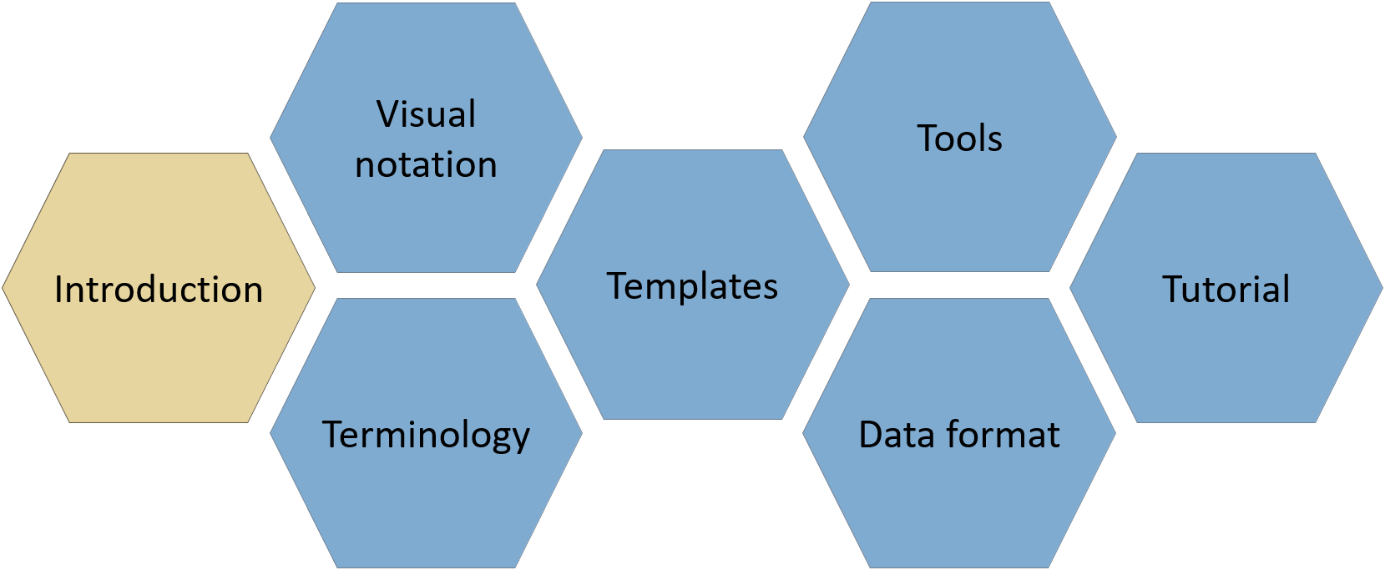

About
CJML consists of several modules, each covering a different aspect of the language. All resources are available at www.cjml.no
Diagram types, symbol gallery, visual features, and examples
Tools for creating and working with journeys
Overview of CJML, its conceptual foundation, and a quick tour of the visual notationapproach
Guidance on journey thinking, journey data, approaches to analysis, and use cases
Definitions, metamodel, class diagrams, and model attributes
Machine-readable model structure, XML format, and data exchange
PowerPoint templates for quick, flexible diagramming with examples
Contact us: For questions or feedback, contact us at CJML<at>sintef.no
CJML v3 was developed as part of the research project Smart Journey Mining, funded by the Research Council of Norway (grant no. 312198).
How you may use this material: © SINTEF, licensed under
CC BY-SA 4.0. You may use, share, and adapt it with attribution, with adaptations shared under the same license.

Slide 3
Content
Introducing CJML
  Defining customer journeys
  CJML key facts and domains
  Target group
  Development and origin
A quick tour of CJML
  Diagram types and examples
  Comparison of diagram types
  Customer experience
  Summary of visual syntax
Theoretical foundation and modeling principles
  Planned and actual journeys
  Actors and touchpoints
  Classification of communication points
  Abstraction and granularity
From scenario to journey
  Example – home alarm service
  From business scenario to planned journey
  From user scenario to actual journey
3

Slide 4



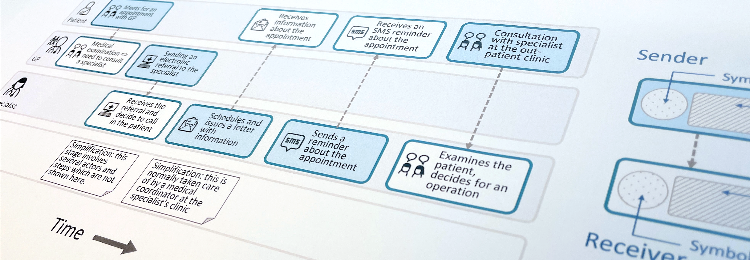
Customer Journey Modeling Language
CJML is a visual language for modeling the journey of an individual, regardless of whether the person has the role of customer, user, employee, patient, or citizen.
CJML consists of terminology, visual notation, a machine-readable data format, methods, and supporting tools
Customer journey
User journey
Employee journey
Patient journey
Citizen journey
4

Slide 5

Introducing CJML
Defining customer journeys
CJML key facts
CJML domains
Target group
Development and origin

Slide 6
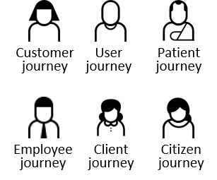
Defining customer journeys
Master ( => Tutorial)
Definition: A customer journey is defined as a sequence or constellation of touchpoints required for a customer to achieve a specific goal or a desired outcome.
Customer journey methods and formats vary considerably. Nevertheless, all approaches share three fundamental characteristics:
  The journey is viewed from the end user’s perspective
  The journey unfolds over time as a process
  The journey is divided into steps called touchpoints
The customer journey concept is equally applicable to users,
employees, clients, patients, citizens, and other end users.
A journey may be experience-oriented or mundane, voluntary
or mandatory, and may even lead to an undesirable outcome
(e.g., filing a tax return may result in an additional tax payment)
Introducing CJML
A quick tour of CJML
Theoretical foundation and modeling principles
From scenario to journey

Slide 7
About customer journeys
Master ( => Tutorial)
The term customer journey originated in commercial settings but is now used across many service domains.
A customer journey map is a visual representation where touchpoints are arranged along the horizontal axis in chronological order.
The map often includes the end user's experiences and emotions.
Journeys are often divided into before, during, and after the service, although these boundaries may be difficult to define.
Although customer journey mapping is widely used, it has traditionally lacked a formal language and specification.
CJML provides an approach to addressing this gap.
Service domain examples
Hospitality: Going to the cinema. The journey may include booking and paying for a ticket, arriving at the cinema, and watching the movie.
Healthcare: Undergoing knee surgery. The journey may include a GP visit, MRI, specialist consultations, surgery, and follow-up with different healthcare providers.
Introducing CJML
A quick tour of CJML
Theoretical foundation and modeling principles
From scenario to journey

Slide 8
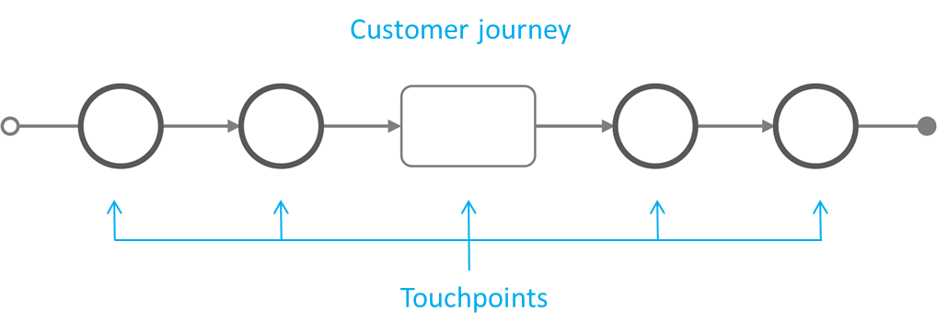
CJML key facts I
CJML is a formal language for specifying and visualizing customer journeys modeled as sequences of touchpoints.
CJML is centered on humans and their activities, regardless of whether the person has the role of customer, user, employee, patient, or citizen.
CJML consists of terminology, visual notation, a machine-readable data format, methods, and supporting tools.
Actors and touchpoints are the two fundamental concepts of a customer journey, each defined by a rich set of attributes in the CJML metamodel.
Note that the visual notation represents only part of the CJML language. Additional information is captured in model attributes that are not shown in the diagrams.
💡
CJML distinguishes between touchpoints that communicate a message (circle) and those that do not (square).
Introducing CJML
A quick tour of CJML
Theoretical foundation and modeling principles
From scenario to journey

Slide 9
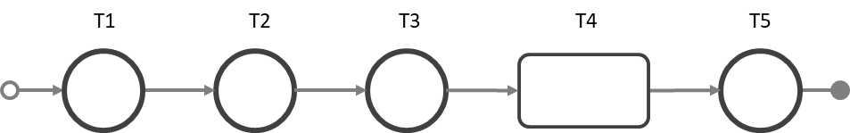
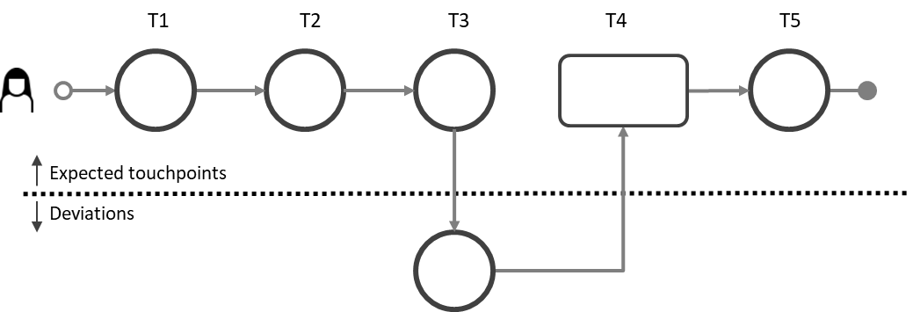
CJML key facts II
CJML differs from other process modeling languages in two principal ways:
  CJML models service processes from the end-user’s perspective
  CJML aims to be intuitive for a broad range of users
CJML describes service processes in two states:
  Planned journey – the hypothetical state of a service process
  Actual journey – the service process as experienced by an individual end user
Planned journey
Actual journey
💡
A deviation diagram visualizes compliance with the planned journey. Read more about compliance in the Visual Notation module.
Introducing CJML
A quick tour of CJML
Theoretical foundation and modeling principles
From scenario to journey

Slide 10
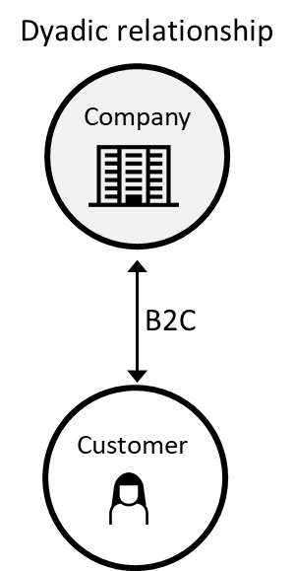
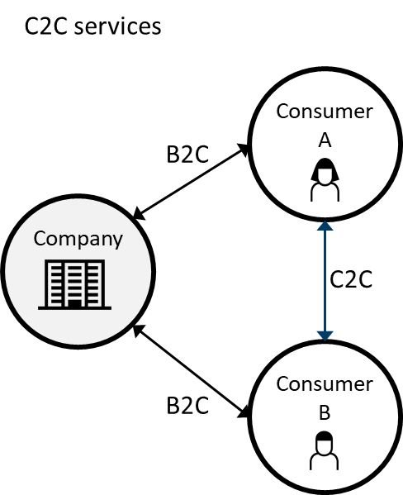
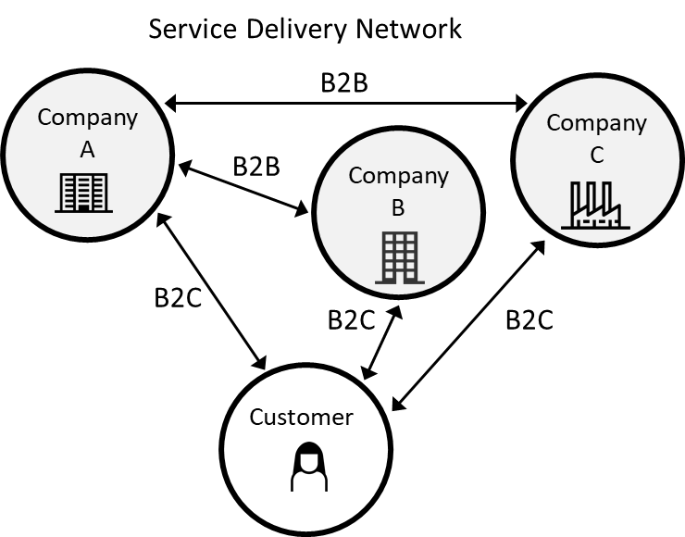
CJML key facts III
CJML addresses the detailed interactions between an end user and one or more service providers.
CJML is well suited for service processes that extend over time and are mediated through different communication channels.
CJML is particularly well suited for technology-driven service processes that are repeated at high volumes.
Service delivery models may be dyadic, consumer-to-consumer via a service provider, or based on networks of collaborating service providers.
Introducing CJML
A quick tour of CJML
Theoretical foundation and modeling principles
From scenario to journey

Slide 11
CJML domains
CJML consists of a Core and two domain-specific additions.
The Core contains the common concepts, terminology, and visual notation for journey modeling, and is formally defined by a conceptual metamodel and represented in the machine-readable data format.
The Healthcare domain is extensively supported within the Core, with metamodel extensions and visual symbols.
The Cybersecurity and Data privacy additions currently provide visual notation only (see Visual Notation and Templates).
CJML core
Healthcare
Cybersecurity
Data privacy
Introducing CJML
A quick tour of CJML
Theoretical foundation and modeling principles
From scenario to journey

Slide 12
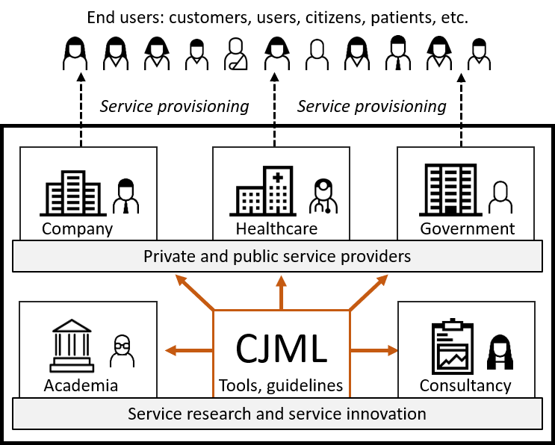
Target group of CJML
People whose journeys are modeled
People using CJML
CJML is relevant to service designers, business developers, customer support staff, analysts, researchers, and others involved in service delivery.
The core elements of CJML are intended for anyone in a service-providing organization and do not require a technical background.
The more advanced features of CJML target analysts, system developers, and researchers.
Systematic evaluations have shown that new users can quickly learn CJML and create journey diagrams with a high level of precision.
Halvorsrud, R., Haugstveit, I. M., & Pultier, A. (2016). Evaluation of a Modeling language for customer journeys. Proceedings from the IEEE Symposium on Visual Languages and Human-Centric Computing, pp. 40-48. IEEE Xplore. doi:10.1109/VLHCC.2016.7739662
Introducing CJML
A quick tour of CJML
Theoretical foundation and modeling principles
From scenario to journey

Slide 13
Development and origin
Guideline 1: Design as an Artifact.
Guideline 2: Problem Relevance.
Problem relevance and user require-ments have been derived through operational work with case partners, interviews with stakeholders, literature studies, and surveys.
Guideline 3: Design Evaluation.
CJML has been evaluated continuously through both informal evaluation (case studies, workshops, external input) and formal evaluation using controlled experiments.
Guideline 4: Research Contributions.
Guideline 5: Research Rigor.
Guideline 6: Design as a Search Process.
Guideline 7: Communication of Research.
CJML constitutes a new approach to customer journey methodology, allowing for detailed and precise modeling of actual journeys and the comparison of these against planned journeys.
A mixed method approach has been used to develop and evaluate CJML, e.g., interview, case study, survey, and controlled experiment. CJML is defined through a set of specification documents and design templates.
An UCD approach has been applied throughout with frequent iterations with the target group. We have also received continuous feedback from external users.
CJML has been publicly available online throughout the development process. CJML has been presented in academic and practice-oriented conferences, reaching both technology- and management-oriented audiences.
CJML is an artifact developed for precise modeling of customer journeys to support journey discovery, journey conformance, and journey redesign.
CJML has been developed in close collaboration with industry partners through a series of research and innovation projects since 2012.
Details about the development of CJML can be found in Halvorsrud et al. (2024).
The development of CJML follows the seven guiding principles of design
science research (Hevner et al. 2004).
Hevner, A.R., March, S.T., Park, J., Ram, S.: Design science in
information systems research. MIS Quarterly 28(1), 75–105 (2004)
Halvorsrud, R., Sanchez, O., Boletsis, C., & Skjuve, M. (2023). Involving users in the development of a modeling language for customer journeys. Software and Systems Modeling 22.5 (2023): 1589-1618.
Introducing CJML
A quick tour of CJML
Theoretical foundation and modeling principles
From scenario to journey

Slide 14
A quick tour of CJML
Diagram types and examples
Comparison of diagram types
Customer experience
Summary of visual syntax
💡
Only a small selection of CJML’s visual features is shown here. The full specification can be found in the Visual notation document.

Slide 15

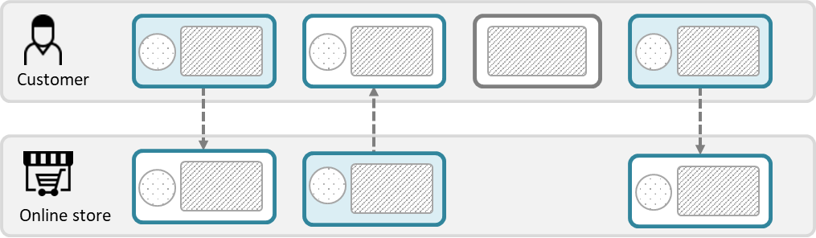
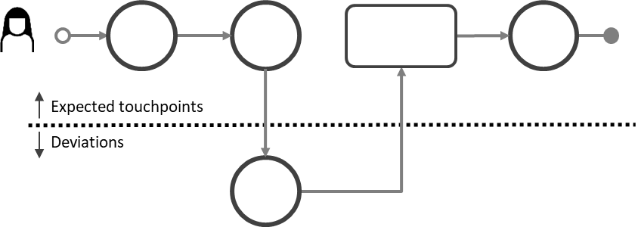
Overview of diagram types
Customer journey diagram
Suitable for journeys with few actors involved
Suitable when highlighting deviations from the planned journey
Journey network diagram (“swimlane diagram”)
Suitable when several actors are involved
Reveals both the sender and the receiver of a communication point
Emphasizes the direction of the message flow
Boundary colors represent the initiator of the communication point and must be used consistently.
Two predefined colors, distinguishing the initiator from the receiver.
Time
An implicit time axis runs from left to right.
This is an example of an actual journey with a deviation.
Time
An implicit time axis runs from left to right.
💡
Note the difference in how a communication point appears in the two diagram types
Introducing CJML
A quick tour of CJML
Theoretical foundation and modeling principles
From scenario to journey

Slide 16
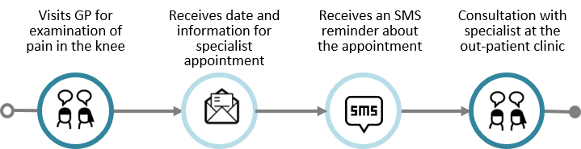
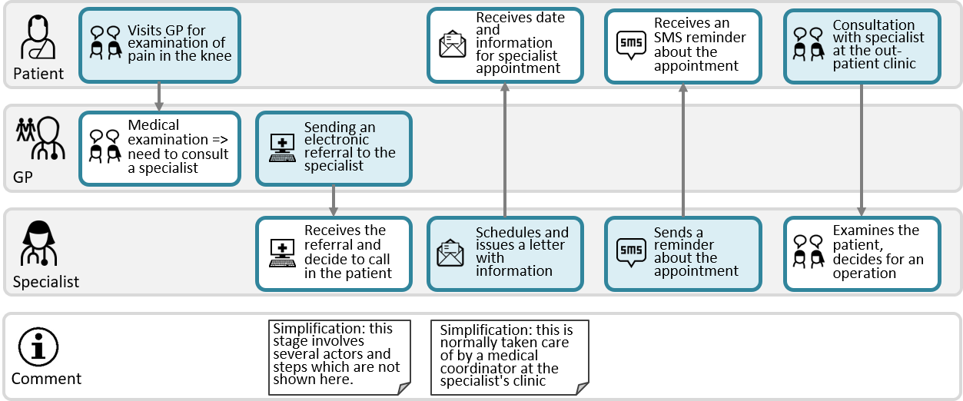
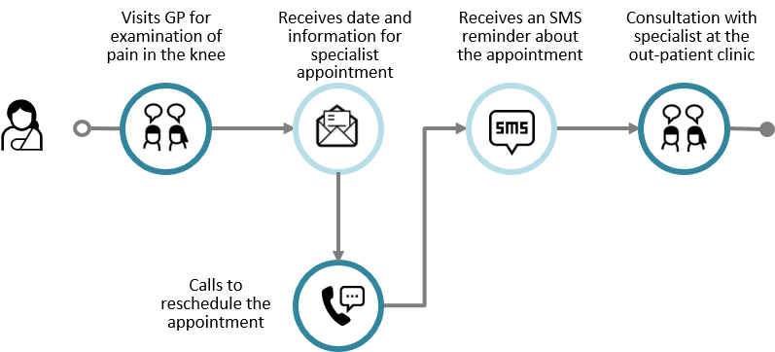
Example: Referral to a specialist
Patient journey diagram
Example of planned journey
Example of actual journey with a deviation
Journey network diagram
A swimlane diagram shows the patient journey, but also the interactions with all the actors in the same diagram
It also reveals behind-the-scenes interactions between other actors that later impact the patient journey (see next slide).
Planned journey
Actual journey
💡
This is an example of a deviation from the planned journey
Introducing CJML
A quick tour of CJML
Theoretical foundation and modeling principles
From scenario to journey

Slide 17










Comparison of diagram types
💡
Note how the patient journey diagram matches the upper swimlane.
Journey diagram
(patient journey)
Visits GP for examination of pain in the knee
Receives date and information for
specialist appointment
Receives an SMS reminder about
the appointment
Consultation with specialist at the
out-patient clinic
Journey network diagram (“swimlane” diagram)
Visits GP for examination of pain in the knee
Receives date and information for specialist appointment
Receives an SMS reminder about the appointment
Consultation with specialist at the out-patient clinic
Patient
💡
Note that this touchpoint is invisible to the patient (and therefore not part of the patient's journey above)
Medical examination => need to consult a specialist
Sending an electronic referral to the specialist
GP
Receives the referral and decide to call in the patient
Schedules and issues a letter with information
Sends a reminder about the appointment
Examines the patient, decides for an operation
Specialist
Simplification: this stage involves several actors and steps which are not shown here.
Simplification: this is normally taken care of by a medical coordinator at the specialist's clinic
Comment
Introducing CJML
A quick tour of CJML
Theoretical foundation and modeling principles
From scenario to journey

Slide 18
Customer experience
When representing customer experience or user experience (UX), CJML adheres to principles from HCI research*;
  UX is subjective
  UX is dynamic
  UX is context dependent
UX is thus associated with actual journeys only.
UX is based on a user's self-reported input.
  Otherwise, it must be flagged as "anticipated user experience"
UX can be expressed in various ways, depending on the diagram type.
  Swimlane diagram: in a separate swimlane
  Journey diagram: as callouts from a communication point
💡
CJML insists that a user's experience is individual and thus cannot be assigned to a journey on a general level. In this way, CJML differs from the majority of other customer journey approaches.
* See for example Law, E. et al. (2009). Understanding, scoping and defining user experience: a survey approach. Proceedings of 27th SIGCHI conference on Human factors in computing systems (pp. 719-728).
Introducing CJML
A quick tour of CJML
Theoretical foundation and modeling principles
From scenario to journey

Slide 19
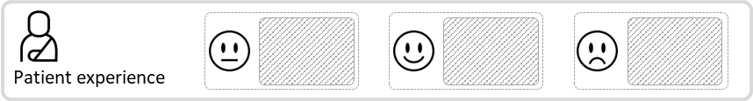
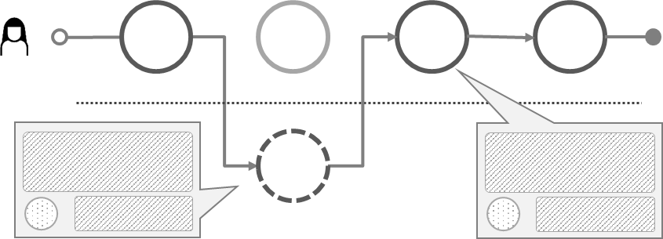
Customer experience
Text based on user's self-reported input
Rating-based emoticon
Journey network diagram
Text based on the user's self-reported input
Journey diagram
Rating-based emoticon
Introducing CJML
A quick tour of CJML
Theoretical foundation and modeling principles
From scenario to journey

Slide 20
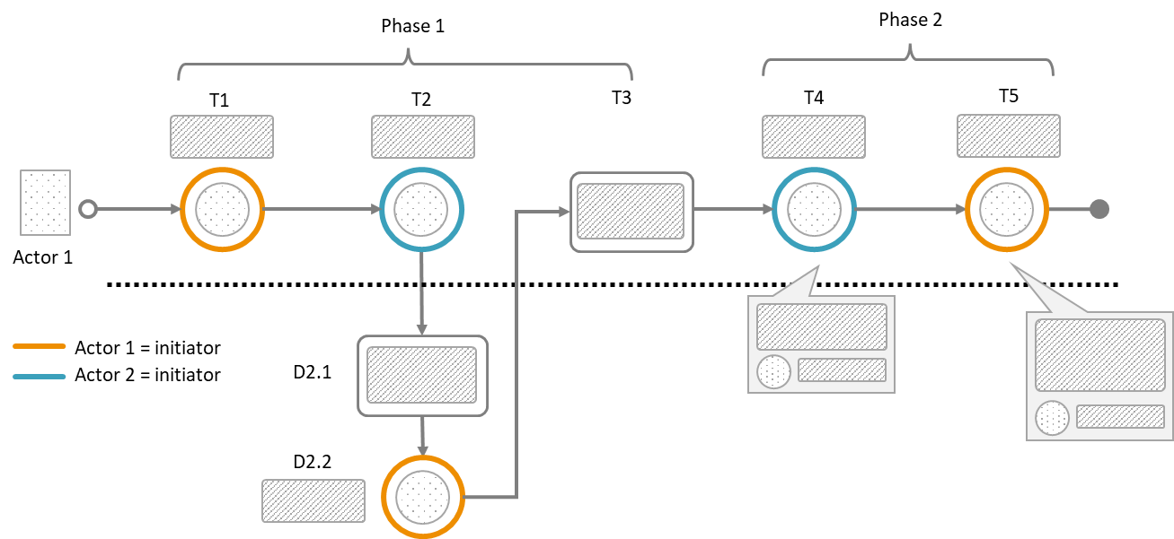
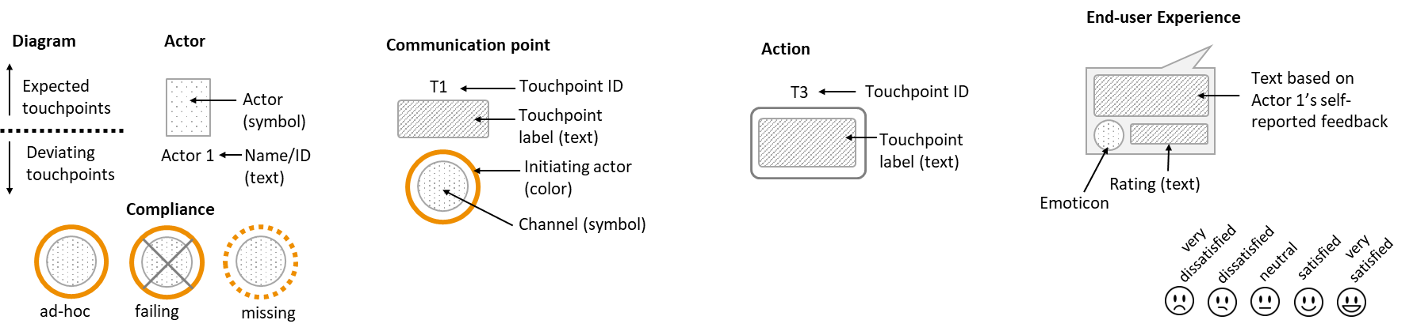
Summary of visual syntax - Customer journey diagram
Legend
Overview
Symbols
Customer journey diagram
Journey network diagram
Customer experience
Appendix

Slide 21
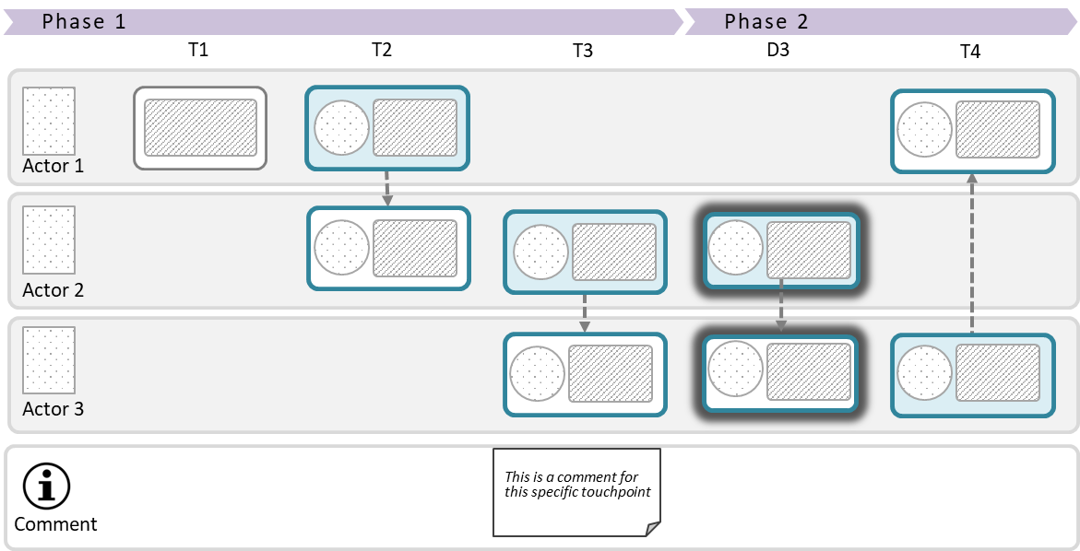
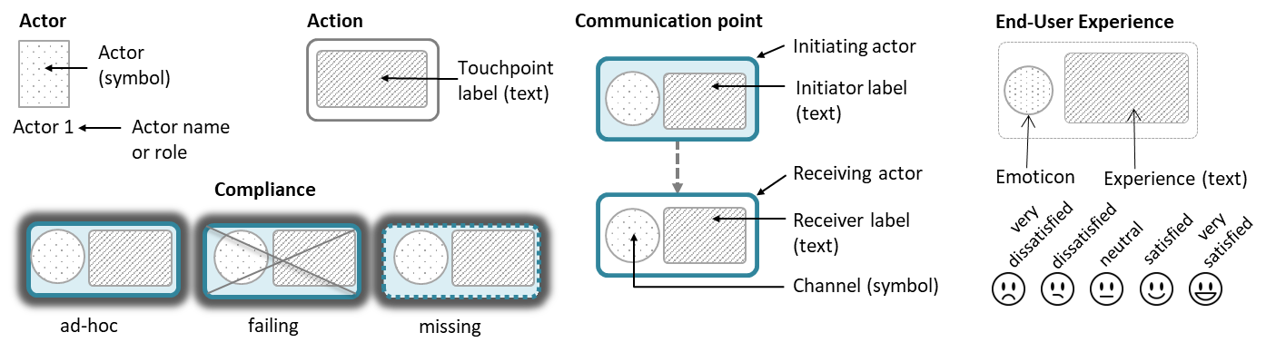
Summary of visual syntax - Journey network diagram
Legend
Overview
Symbols
Customer journey diagram
Journey network diagram
Customer experience
Appendix

Slide 22
Theoretical foundation and modeling principles
Planned and actual journeys
Actors and touchpoints
Classification of communication points
Abstraction and granularity

Slide 23
Two states of a journey
The planned journey...
The actual journey...
reflects how the service process is implemented by the service provider(s) - regardless of whether it was deliberately designed or resulted from ad-hoc development.
may branch into alternative paths as a result of decisions made by the user (e.g., preferred channel) or the service provider.
always involves an individual end-user.
may comply with the planned journey, but often deviates from it.
is associated with end user experience, which is subjective, context dependent, and may change over time.
Planned journey = “theory”
Actual journey = reality
Introducing CJML
A quick tour of CJML
Theoretical foundation and modeling principles
From scenario to journey

Slide 24
Two types of touchpoints
A journey is modeled as a sequence of touchpoints required for a human user to achieve a specific goal.
The scope of a journey should be defined in relation to the purpose of the study.
Communication points are instances of communication or interaction between a user and a service provider
Actions are non-communicative events or activities conducted by an actor as part of a customer journey
💡
There are two different types of touchpoints.
💡
This diagram is called the customer journey diagram. There is also a second diagram type available for journeys involving many actors.
Introducing CJML
A quick tour of CJML
Theoretical foundation and modeling principles
From scenario to journey

Slide 25
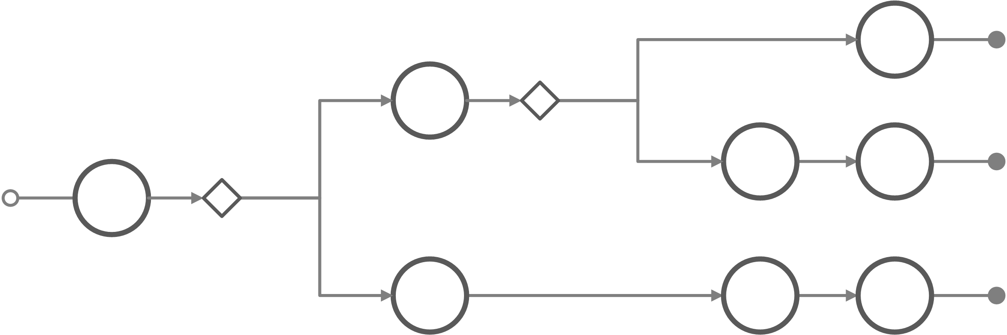
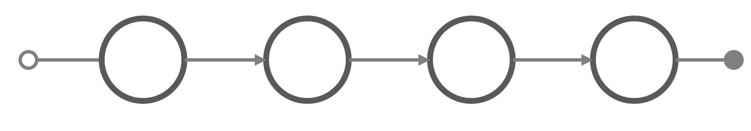
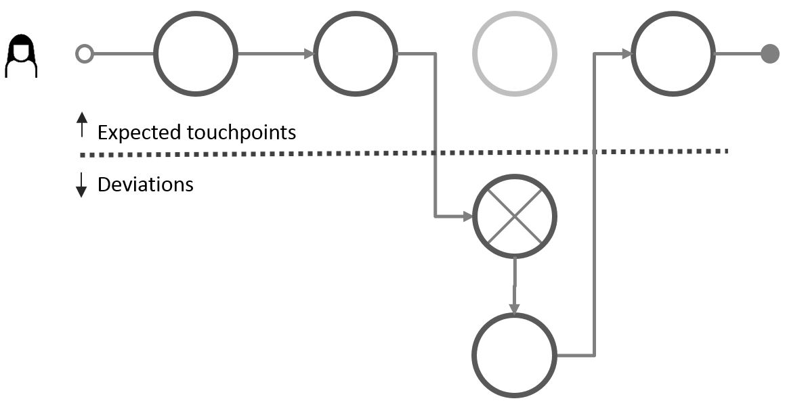
Group versus single journey
The planned and actual service processes are modeled as planned and actual customer journeys, respectively. Generic journeys represent collections of alternative paths through a service process.
  Group of planned journeys
  A set of related journeys that represent alternative ways to achieve a common user goal (e.g., parallel channels). Alternatives may also result from configurations and dependencies in the business case.
  Planned journey
  One specific journey, as implemented (or planned for the future) by the service provider, given the service conditions
  Actual journey
  The customer journey as experienced by an individual customer during execution of the service process. The example shows several deviations.
💡
An actor’s symbol at the beginning of a journey indicates an actual journey.
Introducing CJML
A quick tour of CJML
Theoretical foundation and modeling principles
From scenario to journey

Slide 26
Example: Group of planned journeys
Each circle represents a communication point through which the customer and company communicate, for example by e-mail, SMS, or app.
1
A utility company offers five different ways to become a new customer.
2
3
The many choices of communication channels result in N = 648 unique, alternative journeys
4
All the digital touchpoints leave traces and involve internal systems and work processes.
5
Number of journeys =
9 x 18 x 4 = 648

Slide 27

Example: Peter’s actual journey
Peter, a new customer, chooses to sign up through the website. His journey is highlighted.
Peter has “executed” one of the 648 possible paths. The journey consists of 13 touchpoints.
This was not very easy!
I prefer to order through the website.
💡
Peter has a subjective, dynamic customer experience throughout his journey.
Number of journeys =
9 x 18 x 4 = 648

Slide 28

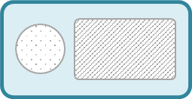
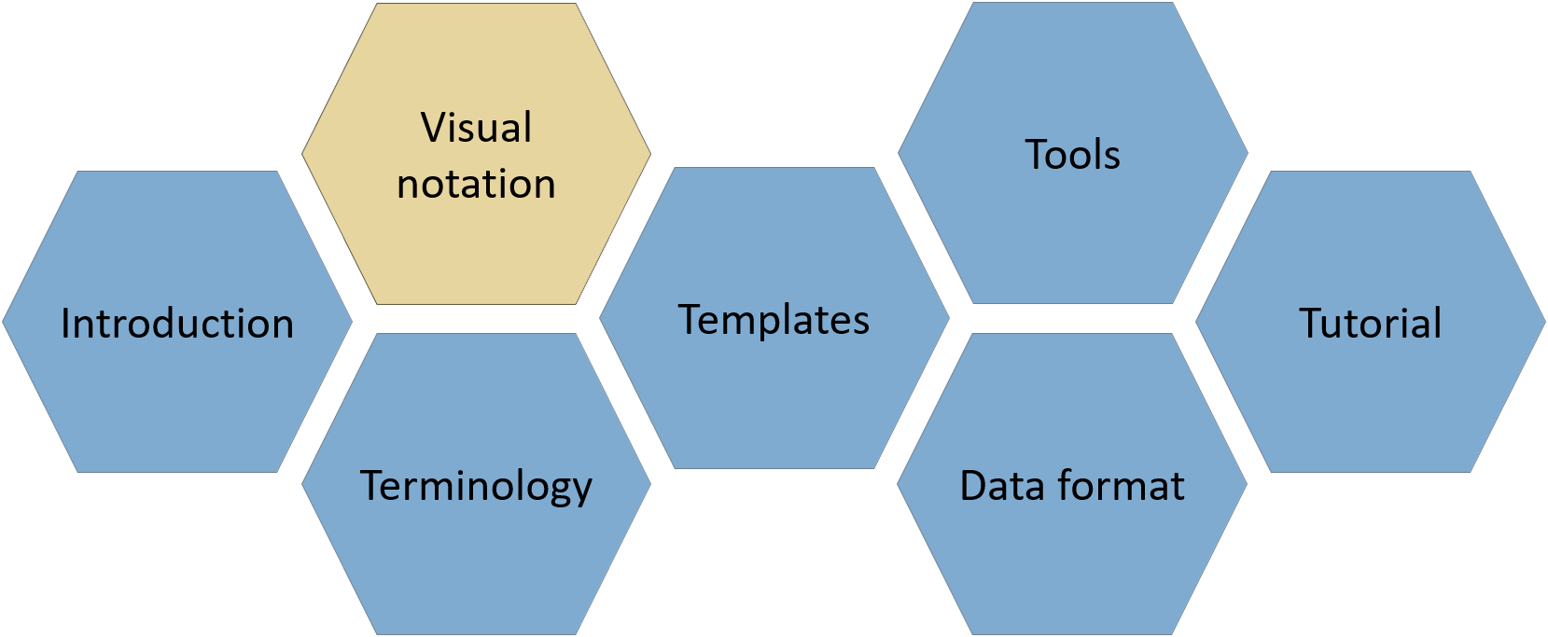

Modeling of communication points
Communication is based on a semiotic model in which a sender transmits a message to a receiver through a communication channel.
Message
Communication channel
Actor 1
(initiator)
Actor 2
(receiver)
De Souza, The Semiotic Engineering of Human‐Computer
Interaction (Cambridge. Mass: MIT Press, 2005), 283.
Visual representation of a communication point
💡
The visual appearance of touchpoints depends on the diagram type.
Customer journey diagram
Journey network diagram
💡
Further details about the two diagram types can be found in the Visual notation module.
Communication channel
Communication channel
text area
Actor 1
(initiator)
Actor 1
(initiator)
message flow
Actor 2
(receiver)
text area
Useful for simple journeys and for showing deviations from the planned journey.
Useful for journeys with several actors, and for showing both initiator and receiver.
Introducing CJML
A quick tour of CJML
Theoretical foundation and modeling principles
From scenario to journey

Slide 29




Actors involved in a customer journey
Directly involved actors
The actors on the left are directly involved in delivering the service to the customer. They have predefined roles in the service delivery.
The focal actor
The end user has a special role as the journey’s focal point.
External actors
The external actors on the right may influence the customer’s journey but have no predefined role or responsibility in the service delivery.
Example: For an online purchase, the directly involved actors may include the online retailer and a service partner providing the logistics service.
Example: For an online purchase, external actors may include a newspaper that made the customer aware of the product or a friend who recommended it.
Main service provider
(Online retailer)
External person
(Friend)
End user
(Customer)
Service partner
(Logistics company)
External organization
(Newspaper)
💡
Customers often perceive the service as being delivered by the main service provider, regardless of the service partners involved or their respective responsibilities.
Introducing CJML
A quick tour of CJML
Theoretical foundation and modeling principles
From scenario to journey

Slide 30


Touchpoints – the atoms of a journey
💡
See the Tutorial module for guidance on granularity and level of detail.
Touchpoints are of two types: communication points and actions.
Communication points are moments of interaction or communication between the customer and other actors.
Actions are steps that does not involve directed communication (not shown here).
The color of the circle boundary indicates the initiating actor. By convention, touchpoints initiated by the customer are shown in orange.
💡
The illustration shows outgoing touchpoints– initiated by the customer
Main service provider
(Online retailer)
External person
(Friend)
End user
(Customer)
Service partner
(Logistics company)
External organization
(Newspaper)
💡
A communication point is associated with
an initiator (sender) and a receiver
a communication channel through which the message is conveyed
a temporal reference (e.g., timestamp or sequence order)
Introducing CJML
A quick tour of CJML
Theoretical foundation and modeling principles
From scenario to journey

Slide 31




Touchpoints – the atoms of a journey
Touchpoints are of two types: communication points and actions.
Communication points are moments of interaction or communication between the customer and other actors.
Actions are steps that does not involve directed communication (not shown here).
Touchpoints initiated by directly involved actors or external actors use a dedicated color assigned to each actor.
💡
The illustration shows incoming touchpoints – received by the customer
Main service provider
(Online retailer)
External person
(Friend)
End user
(Customer)
Service partner
(Logistics company)
External organization
(Newspaper)
💡
When many actors are involved, the color coding may become difficult to follow. In such cases, a diagram with actor swimlanes may be more suitable.
Introducing CJML
A quick tour of CJML
Theoretical foundation and modeling principles
From scenario to journey

Slide 32

Touchpoint framework
💡
The Tutorial module explains how to distinguish between actions and communication points.
Directly involved actors
The actors on the left side are directly involved in delivering the service to the customer. They are responsible for (parts of) the customer's journey.
External actors
The actors on the right side may influence the customer's journey, although they are not responsible for any part of the service delivery.
Direct communication
Steps involving a sender, a receiver and a communication channel in the context of the customer's journey.
Communication point
External communication point
Communication with the service provider or the service system. Often part of the planned journey.
Communication with an external actor who is not involved in the service provision.
No communication
Steps without communication are called actions. Non-communicated observations and cognition are included here.
Action
External action
Action involving the service system.
Action not involving the service system.
Lisa grabs a shopping cart at the mall
Lisa writes a shopping list at home
💡
These touchpoints involve the service system and can be controlled (to some extent) by the service provider.
💡
These touchpoints occur outside the service system and cannot be controlled by the service provider.
Introducing CJML
A quick tour of CJML
Theoretical foundation and modeling principles
From scenario to journey

Slide 33
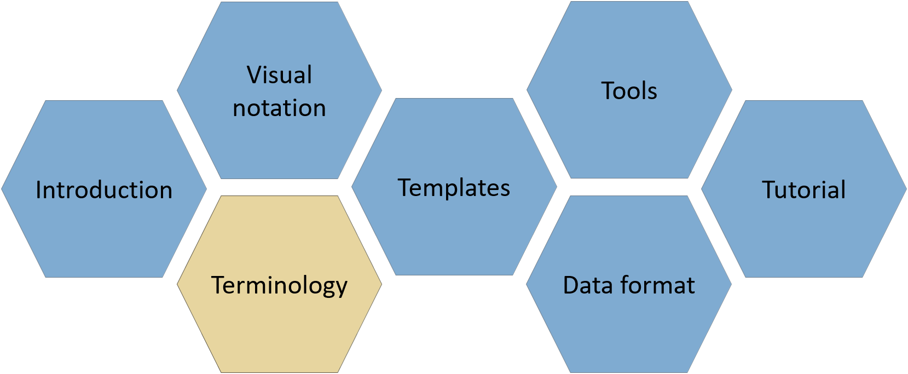
CJML formalism
💡
The Terminology document provides definitions and detailed class diagrams.
The abstract syntax of CJML is described through a metamodel
The main terms are journey, actor, and touchpoint
Planned and actual touchpoints have different attributes
  Planned touchpoints have relative timestamps, while actual touchpoints have absolute timestamps
  Only actual touchpoints have user experience
  Actual touchpoints may have compliance values (planned, ad-hoc, failing, missing)
Actual Touchpoint
touchpointID: String timeStarted: Datetime timeCompleted: Datetime compliance: complianceValues uncertainty: uncertaintyValues [0..4] comment: String touchpointCategory:classification
Planned Touchpoint
touchpointID: String deltaTime: Float touchpointDuration: Float uncertainty: uncertaintyValues [0..4] comment: String touchpointCategory:classification
End User Experience
Planned Action
Planned Communication Point
Actual Action
Actual Communication Point
Introducing CJML
A quick tour of CJML
Theoretical foundation and modeling principles
From scenario to journey

Slide 34
About touchpoint category
💡
Full definitions are provided in the CJML Terminology module.
Touchpoints can be classified according to their function in the journey, making it easier to focus on specific aspects.
The categories are intentionally generic and can be applied across different service domains.
CJML defines 11 categories.
  Core encounter: The main value-creating step
  Supportive encounter & handover: Supporting activity or transfer of responsibility
  Confirmation: Something is confirmed
  Status update: Something has changed
  Notification: Something is available
  Reminder: Don't forget
  Inquiry: A question is asked
  Instruction: What to do
  Authentication & authorization: Prove who you are
  Payment or financial interaction: Money changes hands
  Other: None of the above
Introducing CJML
A quick tour of CJML
Theoretical foundation and modeling principles
From scenario to journey

Slide 35
Granularity and precision
💡
CJML supports abstraction through journey phases, for example: before the journey, during the journey, and after the journey. More information can be found in the Terminology and Visual Notation modules.
Service processes consist of activities that can be broken down into increasingly detailed steps, making it necessary to decide which steps should be represented in the model.
The general rule is to divide the process into touchpoints representing the smallest meaningful unit of content, taking the purpose of the modeling into account.
A new touchpoint is created whenever one of the following attributes changes:
  The actor changes (for example, in air travel, when moving from the check-in desk to the security check, a new person approaches the traveler)
  The communication channel changes (or the device used by the end user)
  The direction of the message flow changes
Modeling always involves simplification. For example, a phone call involves many detailed steps that are normally irrelevant to the model, such as holding the phone to the ear.
The appropriate granularity depends on the purpose of the analysis. Dialing a telephone number may normally be omitted, but could be essential when analyzing an emergency service.
How much detail? In an end-to-end analysis of an online shopping experience, every click does not need to be modeled as a separate touchpoint. For example, many individual clicks may be grouped into broader touchpoints such as browsing, adding to cart, and completing the order. In a conversion analysis, however, the detailed click path may be the main focus.
Relevance depends on the analysis:
A visit to the doctor involves many actions. Which ones should be modeled depends on the purpose of the analysis.
Often included:
Making the appointment
The doctor's examination and outcome
Sometimes relevant:
Registration upon arrival
Payment
Usually omitted:
Transportation to the doctor’s office
Opening the door to the doctor’s office
Introducing CJML
A quick tour of CJML
Theoretical foundation and modeling principles
From scenario to journey

Slide 36
From scenario to journey
Example – home alarm service
From business scenario to planned journey
From user scenario to actual journey

Slide 37
From scenario to journey
💡
See the CJML Tutorial module for a detailed step-by-step guide
Customer journey models are often derived from scenarios.
A scenario describes a realistic sequence of events in natural language, while a journey model provides a structured representation of the same sequence.
Depending on the purpose, different types of scenarios can be used.
A business scenario describes how a service is intended to work.
  Business scenario → planned journey
A user scenario describes how a specific user actually experiences the service.
  User scenario → actual journey
The following slides use the example of a fictitious home alarm company to illustrate a typical CJML modeling process.
From scenario to CJML
Define the journey context. Identify user goals, key actors, and define the scope.
Outline the journey. Identify the main communications, phases and establish the overall structure.
Identify the touchpoints. Focus on communication, channels, and essential attributes.
Connect the touchpoints. Arrange the touchpoints into a coherent journey, iterate and refine.
Choose the appropriate diagram. Select the diagram and visual notation that best communicates the journey.
Introducing CJML
A quick tour of CJML
Theoretical foundation and modeling principles
From scenario to journey

Slide 38
Example: Home alarm service
💡
This example uses a fictitious company to illustrate how a business scenario can be transformed into a planned
Safe@home is a security company offering installation and maintenance of home alarm systems for the private market.
The company has invested in a new self-service online shop.
A marketing campaign is planned to attract new customers.
To ensure a smooth and consistent customer experience, Safe@home has decided to model the planned onboarding journey for new customers.
Business scenario: see next slide.
Scope: From the customer placing an order in the online shop until payment of the first invoice.
Introducing CJML
A quick tour of CJML
Theoretical foundation and modeling principles
From scenario to journey

Slide 39
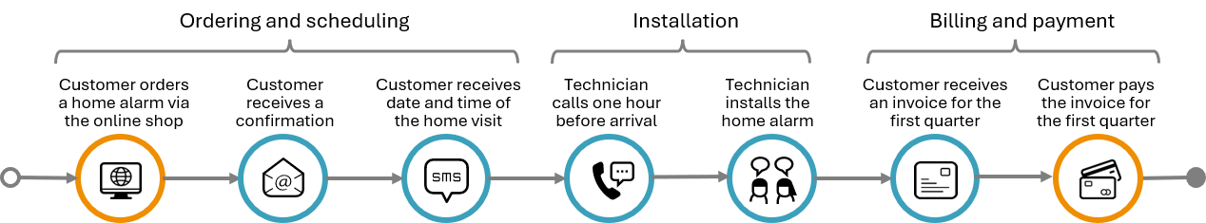
Business scenario => planned journey
The scope of the customer journey is set from the point at which a customer places an order through the online shop, throughout installation and until payment of the first invoice.
Immediately after placing the order in the online shop the customer receives an e-mail that confirms the purchase and provides additional information about the process ahead.
A technician from Safe@home will carry out the necessary installation in the customer's home. After about two days the customer will receive an SMS with the date for the technician's home visit.
On the day of installation, the technician will call the customer about one hour upon arrival, to ensure that the customer is at home. The installation procedure will normally take less than an hour.
A few days after installation, the customer receives a letter from Safe@home containing additional information about the alarm system together with the invoice for the first quarter of the subscription. The customer pays the invoice before the due date.
Introducing CJML
A quick tour of CJML
Theoretical foundation and modeling principles
From scenario to journey

Slide 40
User scenario => Tina’s actual journey
💡
Tina is one of the many new customers going through the onboarding process.
Tina needs a burglar alarm in her home and decides to choose a service offered by Safe@home Inc. Using her laptop, she orders an alarm service from the company's online shop. Everything seems to work fine, and Tina is very satisfied with the online shopping experience. A few minutes later she receives an e-mail confirming the details of the order. She is also informed that a technician will take care of the installation of hardware in her home, and that she will receive an appointment date for the home visit.
A few days later Tina receives an SMS from Safe@home with the date and time for installation. She finds that the suggested date does not suit her plans, as she will be on a business trip at the scheduled time of the home visit. Tina calls the support center but for unknown reasons the connection is broken. She has to leave for an appointment with a friend and decides to call back later.
The following day she is able to reach the call center. A new date is set for the home visit, and immediately after the telephone conversation she receives a confirmation SMS. The following week, on the day of the installation, the technician calls her from his car, telling her he is on his way. The technician installs the alarm system without any problems. After a couple of days, Tina receives a letter containing tips and information. It also includes an invoice for the first billing period. The bill contains items and amounts that Tina is not able to recognize from the marketing campaign. She therefore sends an e-mail to get an explanation. Tina receives an answer by e-mail during the same evening explaining the details of the invoice. As a considerate customer, Tina pays the invoice through online banking the same evening.
Introducing CJML
A quick tour of CJML
Theoretical foundation and modeling principles
From scenario to journey

Slide 41
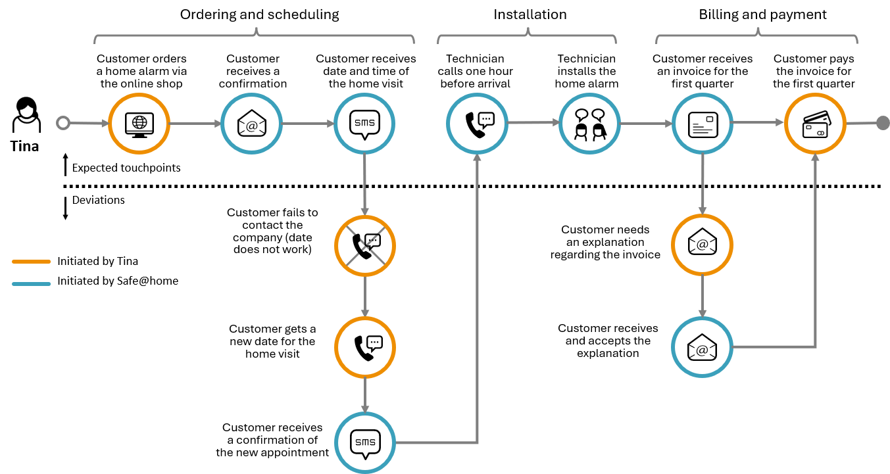
Tina's actual journey
💡
Note that deviations from the expected journey are shown below the dashed line.
Introducing CJML
A quick tour of CJML
Theoretical foundation and modeling principles
From scenario to journey

